Slide 1

Developing a Cloud-Based Application Using Microsoft Azure Services
Group Members: Rohan Kumar (21K-3410) Roain Kumar (21K-3184 )Avinash (21K-3413)Sahil (21K-4696) Ehan Ahmed (21K3366)
Notes:
Entered text
Project Report
Developing a Cloud-Based Application Using Microsoft Azure Services
Course: Introduction to Cloud Computing CS 4037
Instructor: Muhammad Sudais
Semester: Fall 2024
Group Members:
1. Project Overview
The Restaurant Ordering System is a cloud-based application designed to enhance customer and staff interactions. It enables real-time order management, ensuring security, scalability, and performance.
Key Outcomes:
Enhanced customer experience
Centralized order management
Scalable using Azure serverless solutions
2. Objectives
Improve Customer Experience: Enable responsive interface for browsing menus and receiving updates.
Streamline Operations: Facilitate order tracking and error-free processing.
Ensure Scalability & Security: Utilize Azure for high availability and low latency.
3. Application Design and Architecture
Architecture: Azure Active Directory (AAD) for authentication, Azure App Service for hosting, Azure SQL Database for structured data, and Blob Storage for images. Azure Key Vault secures sensitive data.
4. Functional Requirements
The application provides user features, API integrations, cloud hosting, and storage.
5. Non-Functional Requirements
The system ensures performance, scalability, security, and cost optimization.
6. Implementation Details
Challenges included integrating Azure services for deployment and ensuring scalability.
7. Azure Services Configuration
App Service Setup: Hosts customer/admin interfaces.
SQL Database Setup: Configured with a cost-efficient tier.
Key Vault: Securely manages secrets.
Monitoring: Real-time app monitoring setup.
8. CI/CD Pipeline
Implemented continuous integration and deployment using Azure DevOps for smooth updates.
9. Cost Management and Analysis
Resource Costs:
Azure App Service: "Basic" tier
Azure SQL Database: DTU-based model
Blob Storage: "Hot" and "Cool" tiers for cost optimization
Cost Optimization:
Reserved Instances: For cost savings on predictable workloads.
Autoscaling: Efficient resource allocation.
Access Tiers: Optimize Blob Storage costs.
Resource Cleanup: Regular removal of unused resources.
10. Conclusion and Key Learnings
The project successfully implemented a scalable restaurant ordering system using Azure. Key outcomes include a functional web app, an admin portal, and secure data storage.
Key Learnings:
Practical experience with Azure services.
Understanding cloud architecture for scalability, security, and cost optimization.

Slide 2

Introduction
This presentation outlines the development of a cloud-based Restaurant Ordering System using Microsoft Azure Services. The system is designed to improve interactions between customers and staff, focusing on real-time order management while ensuring security, scalability, and performance.

Slide 3
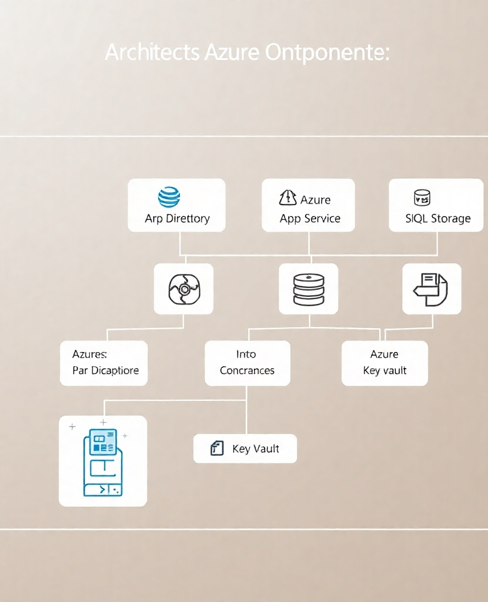
Project Overview
The Restaurant Ordering System aims to enhance the overall customer experience through a centralized platform for order management. Key outcomes of the project include:
Improved customer experience
Centralized order management
Scalability using Azure serverless solutions

Slide 4
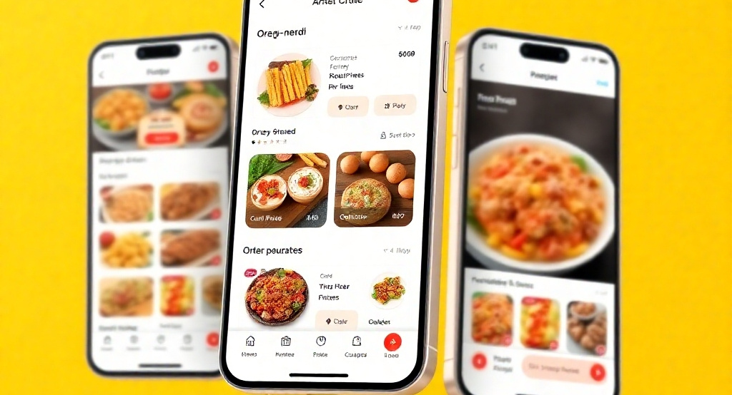
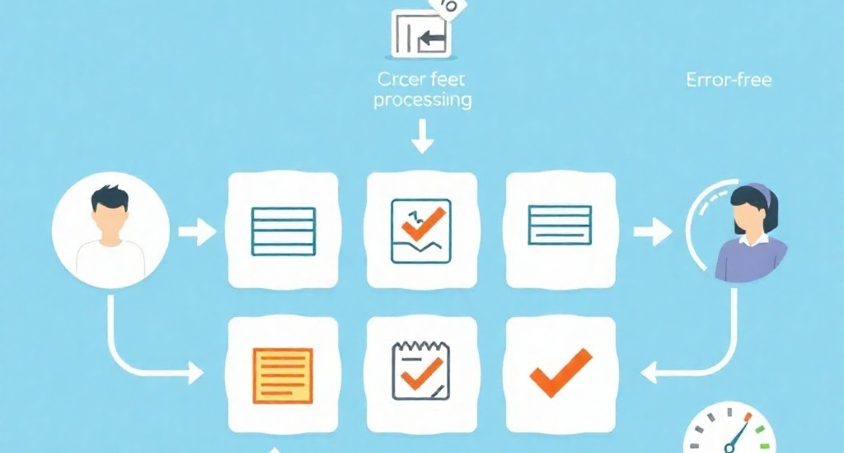
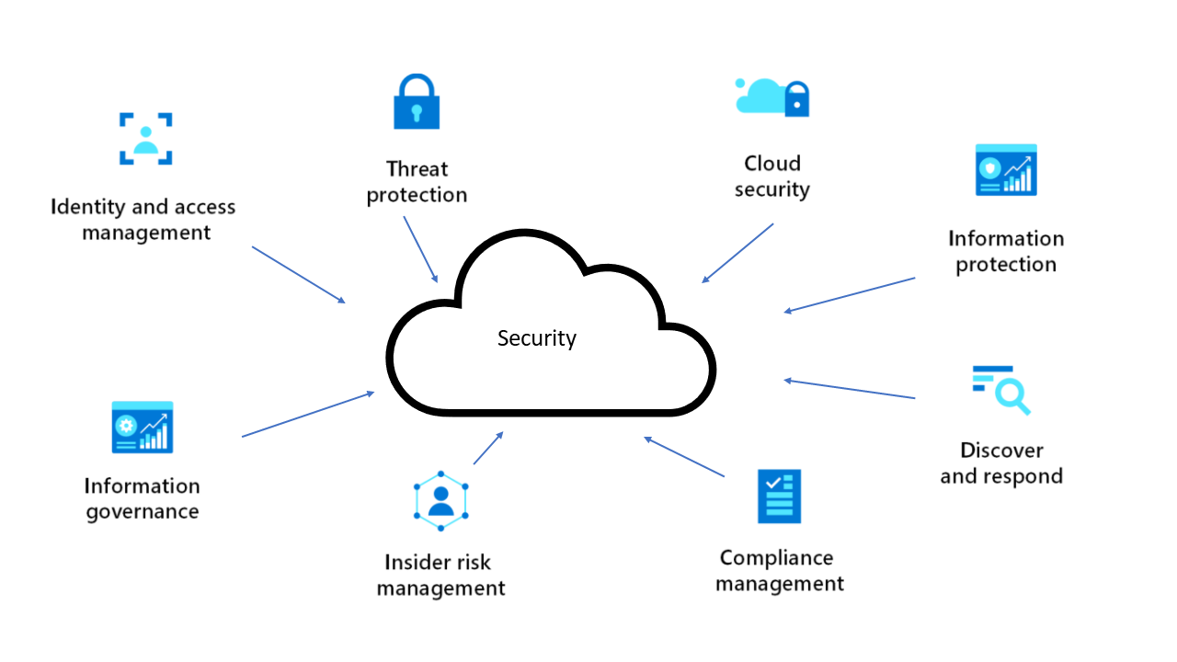
Objectives of the Project
Improving Customer Experience
Streamlining Operations
Ensuring Scalability and Security
The application features a responsive interface that allows customers to browse menus easily and receive timely updates on their orders.
The system facilitates order tracking and ensures error-free processing, optimizing staff efficiency.
Utilizing Azure services ensures high availability and low latency, securing the application against potential threats.

Slide 5
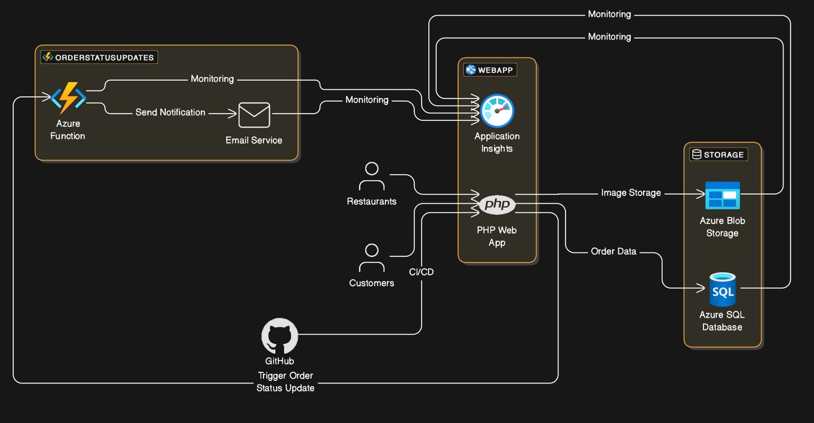
Application Design and Architecture
Architecture Components: The diagram outlines an application architecture using Azure services, a PHP Web App, and GitHub for CI/CD. Key components include Azure Function for notifications, Application Insights for monitoring, Blob Storage for image data, and SQL Database for orders. Customers and restaurants interact via the app, with real-time updates enabled.

Slide 6

Functional Requirements
The application provides essential user features, integrates with various APIs, and utilizes cloud hosting and storage solutions to enhance functionality.

Slide 7
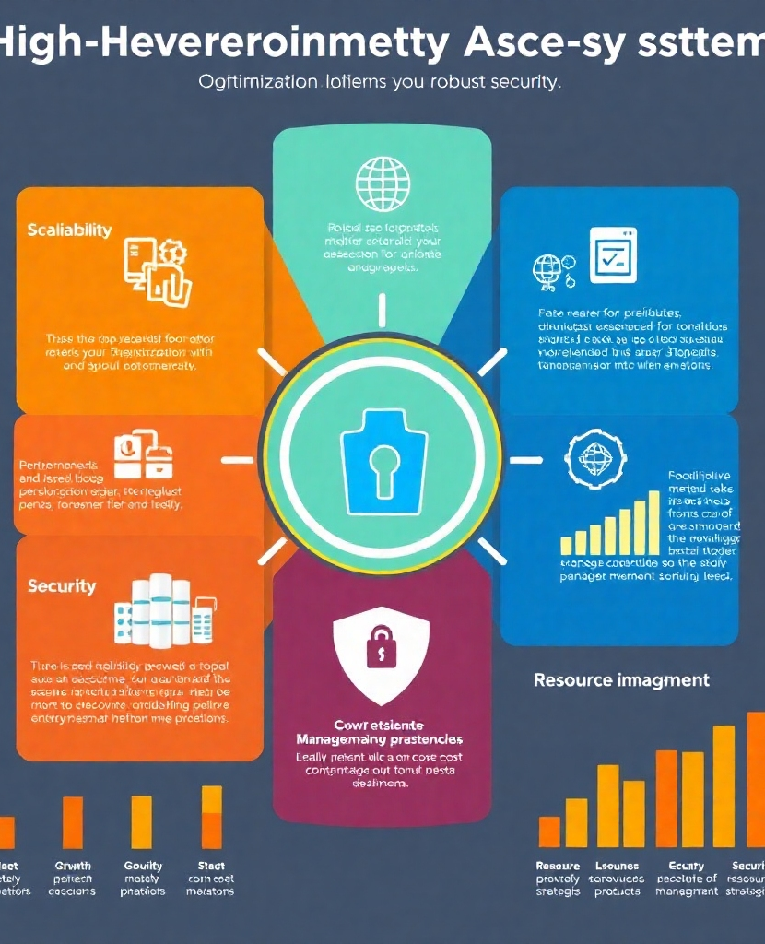
Non-Functional Requirements
The system is built to ensure:
High performance
Scalability to accommodate growth
Robust security
Cost optimization strategies for resource management

Slide 8
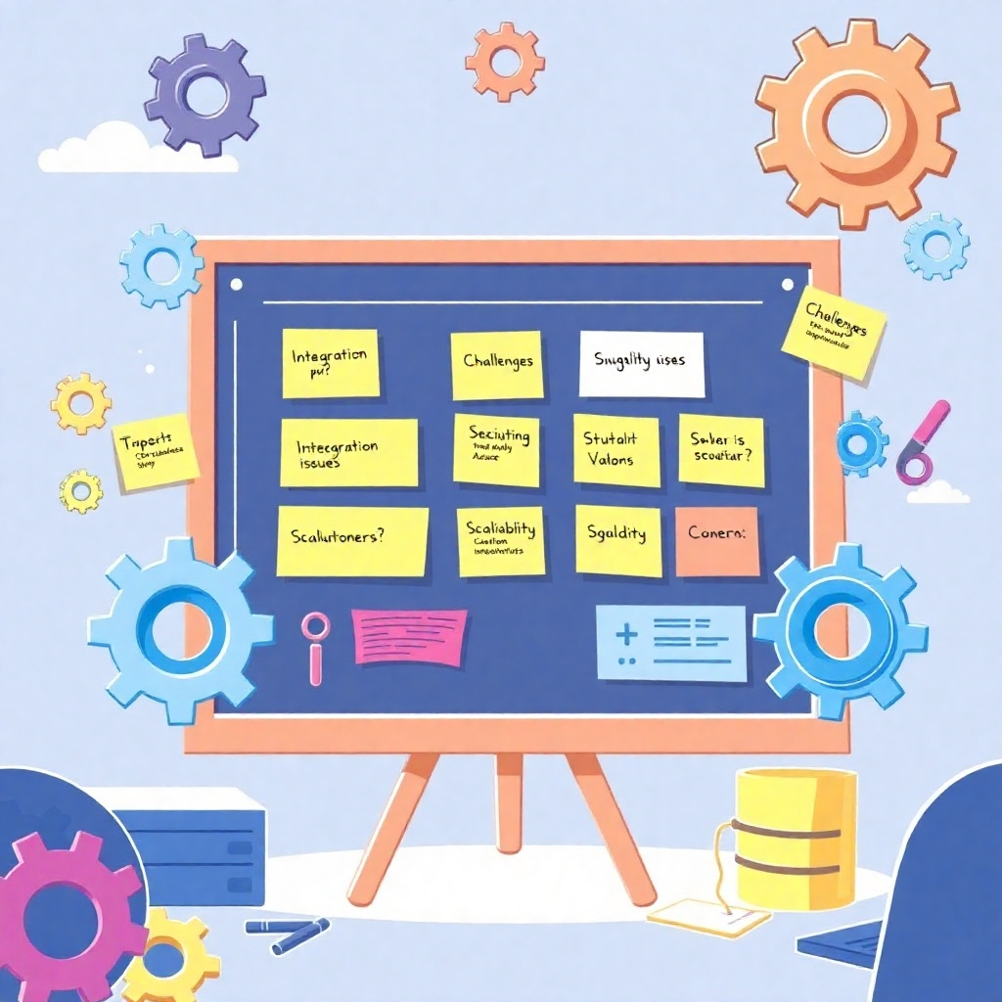
Implementation Details
Challenges Faced and Solutions Implemented: During implementation, challenges included integrating various Azure services effectively for deployment and ensuring that the system could scale as needed.

Slide 9
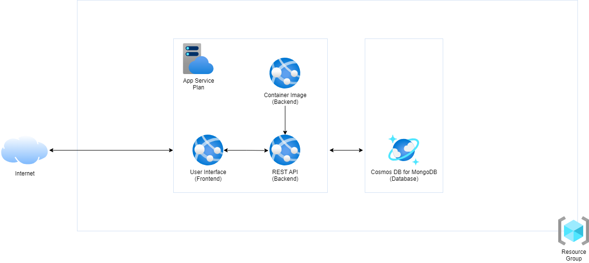
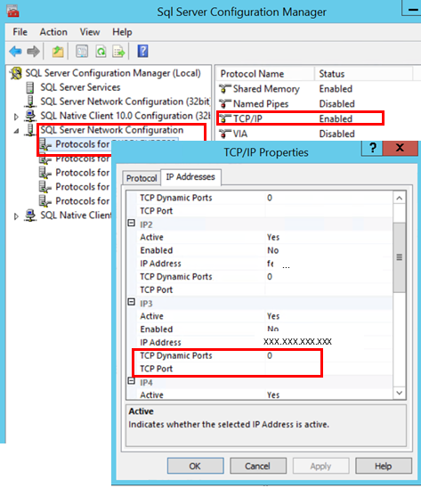
Configuration of Azure Services
App Service Setup
SQL Database Setup
The App Service hosts both customer and admin interfaces, providing a seamless user experience.
Configured with a cost-efficient tier to balance performance and expenses effectively.

Slide 10

Key Vault Configuration
The Key Vault securely manages sensitive data and application secrets.
Monitoring Setup: Real-time monitoring is established to track application performance and identify issues proactively.

Slide 11

CI/CD Pipeline
Continuous Integration and Deployment: Utilizing Azure DevOps, the project implemented a CI/CD pipeline to facilitate smooth updates and maintain application integrity throughout the development lifecycle.

Slide 12
Cost Management and Analysis
Resource Costs:
Azure App Service: Utilized a "Basic" tier for hosting. Azure SQL Database: Implemented a DTU-based model for efficient resource allocation. Blob Storage: Used "Hot" and "Cool" tiers to optimize costs.
Cost Optimization Strategies:
Reserved Instances: For predictable workloads to achieve cost savings. Autoscaling: To ensure efficient resource allocation based on demand. Access Tiers: Optimize Blob Storage costs effectively. Resource Cleanup: Regularly remove unused resources to minimize expenses.

Slide 13
Conclusion and Key Learnings
Key Outcomes of the Project:
Key Learnings:
The project successfully implemented a scalable restaurant ordering system, resulting in a functional web application and an admin portal with secure data storage.
The experience provided practical insights into using Azure services and a deeper understanding of cloud architecture, focusing on scalability, security, and cost optimization.

